Slide 1




IVF-Analysis: A Data-Driven Early Outcome Risk Intelligence System

Slide 2
Contents
Business Objective
Business Constraints
Project Architecture - Data Flow Diagram
Data Collection
Exploratory Data Analysis
Data Visualization
Notes:
Change

Slide 3
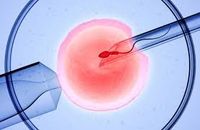

Business Problem
IVF patients show highly variable physiological responses to ovarian stimulation and hormonal treatment protocols. Currently, these responses are assessed only during discrete clinical visits using fragmented reports. Delayed identification of abnormal response patterns increases the risk of complications such as poor ovarian response or ovarian hyperstimulation syndrome (OHSS). The absence of longitudinal trend analytics and real-time monitoring limits timely clinical decision-making, leading to increased adverse events, extended treatment duration, reduced patient safety, and higher overall treatment costs.

Slide 4

Project Overview and Scope
The Data-Driven Early Outcome Risk Intelligence project aims to transition the clinic from reactive clinical assessments to proactive,
trend-based monitoring. By integrating fragmented data—hormonal biomarkers (AMH, E2, P4), follicular development (ultrasound metrics), and
patient demographics—the solution will provide a centralized "command center" for clinicians.
The core of the project is a Near Real-Time Risk Dashboard that uses longitudinal data analytics to flag patients trending toward complications
(like OHSS) or poor response before they reach a critical clinical state.
The scope defines the boundaries of the technical implementation. It is divided into three critical layers:
A. Data Integration & Engineering (The Foundation)
In-Scope: * Consolidating data from Electronic Medical Records (EMR), Laboratory Information Systems (LIS), and manual ultrasound logs.
Standardizing hormonal units (e.g., converting all AMH/E2 readings to a uniform scale).
Building data pipelines that sync near real-time updates from stimulation cycles.
Out-of-Scope: Deep historical data migration (older than 5 years) unless required for baseline modeling.
B. Analytics & Risk Intelligence (The "Brain")
In-Scope:
Trend Analytics: Monitoring the "velocity" of hormonal changes (e.g., how fast Estrogen is rising).
Risk Scoring: Developing a weighted scoring system to categorize patients as "Low," "Medium," or "High" risk for OHSS or Poor Response.
Comparative Analysis: Benchmarking a current patient’s response against historical "Success" profiles within the same demographic/diagnosis.
Out-of-Scope: Automating medication changes (this remains a manual clinician decision for regulatory compliance).
C. Visualization & Clinical Workflow (The Delivery)
In-Scope:
Clinician Dashboard: A high-level view showing all active stimulation cycles sorted by risk level.
Patient Longitudinal View: A drill-down report showing a single patient's hormonal and follicular
trends over time.
Automated Alerts: Triggering visual flags when a patient crosses a pre-defined physiological threshold.
Out-of-Scope: Patient-facing mobile apps or portals (the focus is strictly on clinician decision support).

Slide 5
Data Dictionary
Field Name | Data Type | Description | Clinical Significance
Patient_ID | String | Unique clinical identifier. | Primary Key for data joining.
Age | Integer | Patient's age at start of cycle. | Primary predictor of oocyte quality.
BMI | Decimal | Body Mass Index (kg/m2). | Influences gonadotropin (Gn) dosing.
AMH_Level | Decimal | Anti-Müllerian Hormone (ng/ml). | Predicts ovarian reserve and OHSS risk.
AFC_Total | Integer | Antral Follicle Count. | Baseline "starting potential" for the cycle.
Cycle_Day | Integer | Days since start of stimulation. | X-axis for all trend visualizations.
Gn_Dose | Integer | Daily Gonadotropin dose (IU). | The "input" variable for stimulation.
E2_Level | Decimal | Estradiol level (pg/ml). | Speed of rise flags OHSS risk.
P4_Level | Decimal | Progesterone level (ng/ml). | Early rise flags premature luteinization.
Follicle_Size_Avg | Decimal | Mean diameter of lead follicles (mm). | Determines "Trigger" timing for retrieval.
E2_Velocity | Decimal | % change in E2 over last 48 hours. | Key Risk Indicator for hyper-response.
Risk_Score_OHSS | Scale (1-10) | Weighted score based on E2 and AFC. | Visual flag for clinician intervention.
M2_Oocyte_Rate | Percentage | Ratio of mature (M2) to total eggs. | Measures laboratory/stimulation efficiency.
Fert_Rate_2PN | Percentage | % of oocytes successfully fertilized. | Biological success marker for the cycle.

Slide 6
Exploratory Data Analysis [EDA]
Statistical Insights
Business Insights
A Mean AMH is misleading due to these outliers; the Median
is a better baseline for protocol design.
Reducing "Extended Cycles" (those lasting $13+$ days)
through early protocol adjustment can reduce medication
costs by 15-20% per patient and decrease clinician
monitoring hours.
The Standard Deviation of HCG rise is tighter in successful
live-birth outcomes than in biochemical pregnancies.
Early detection allows for "Coastings" or "Trigger Changes"
(using Lupron instead of HCG), which minimizes
Complication-Related Costs—one of your primary success
criteria.
After a certain threshold (often $>300$ IU/day), increasing
the dose does not linearly increase the oocyte count. This is
the Law of Diminishing Returns.
This suggests that "Visual Grading" alone is insufficient for
older patients. Implementing AI-driven embryo selection
or PGT-A (genetic testing) could bridge this gap and
improve the clinic's overall Success Ratio.
Your data shows that cycles lasting 10-12 days of stimulation
have the highest "Good Quality Embryo" rates.
Notes:
EDA is used for seeing what the data can tell us before the modeling task.
Change

Slide 7
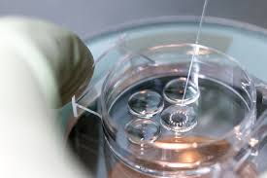
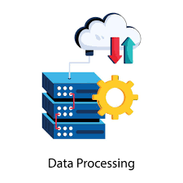

Data Preprocessing
Stage 1: Data Ingestion (The Sources)
We aggregate fragmented data from three primary silos to create a single source of truth.
EMR Data: Patient demographics (Age, BMI) and clinical history.
Lab Information System (LIS): Daily hormonal markers (E2, P4, LH) from ELISA assays.
Medication Records: Daily Gonadotropin (Gn) dosages.
Stage 2: Data Cleaning & Standardization (The "Refinery")
Before analysis, the data undergoes rigorous "Clinical Cleaning":
Unit Normalization: Converting all hormone readings to standard units (e.g., pg/ml for E2).
Handling Nulls: Using "Forward Fill" for ultrasound data (if a scan was skipped on Day 4, use Day 3 as a baseline).
De-duplication: Ensuring multiple entries for a single Patient_ID on the same Cycle_Day are merged.
Outlier Detection: Flagging "impossible" values (e.g., E2 > 20,000 pg/ml) for manual review.
Stage 3: Feature Engineering (The "Intelligence" Layer)
This is where we create the "Early Outcome" metrics that don't exist in raw reports:
Hormonal Velocity: Calculating the 24-hour and 48-hour % change in Estradiol (E2).
Follicle Growth Rate: Tracking the mm/day increase of the leading 3 follicles.
Dose-Response Ratio: Measuring how many follicles are recruited per 100 IU of medication.
Risk Scoring: Running a weighted algorithm to assign a High/Medium/Low risk status.
Stage 4: Data Consumption (The "Dashboard")
The processed data is pushed to the near real-time visualization layer:
API/Push: Data refreshes every 4–6 hours (near real-time).
Visual Output: Trend lines, Gauge charts (for success rates), and Red-Flag alerts.
Notes:
Keep observations

Slide 8
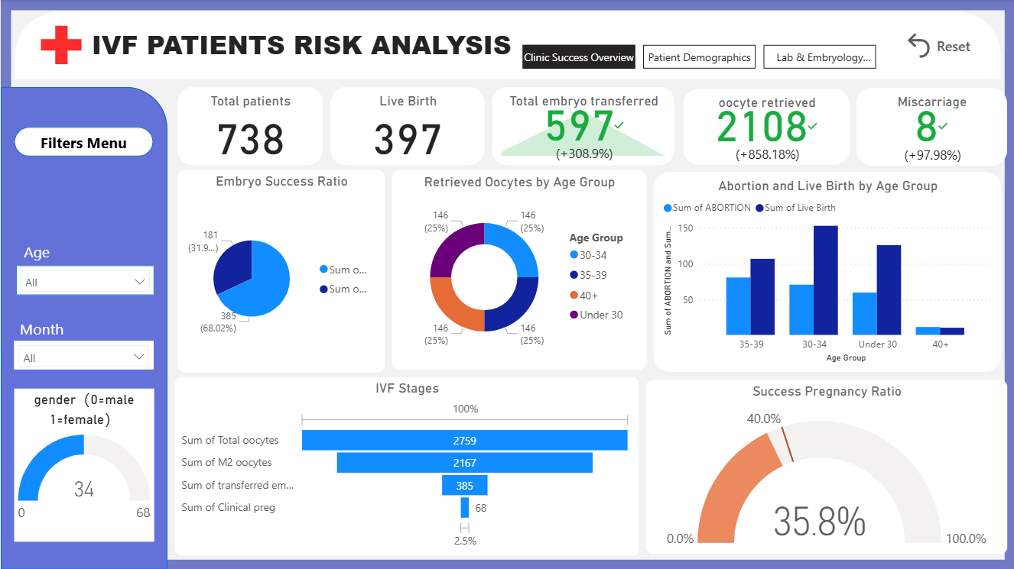
Data Visualization
Notes:
Add graphical

Slide 9
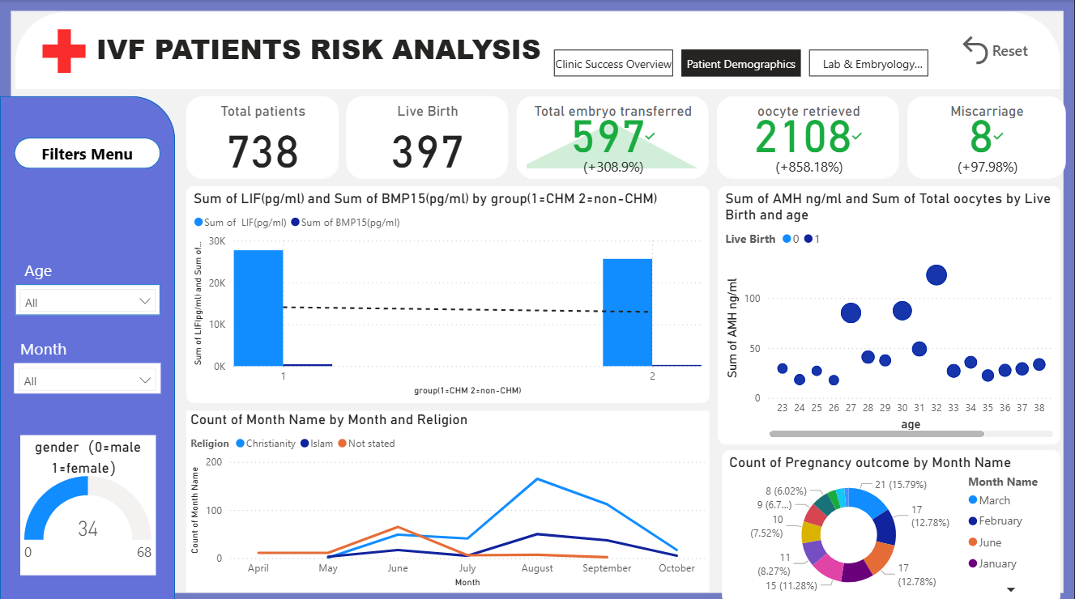
Data Visualization
Notes:
Add graphical

Slide 10
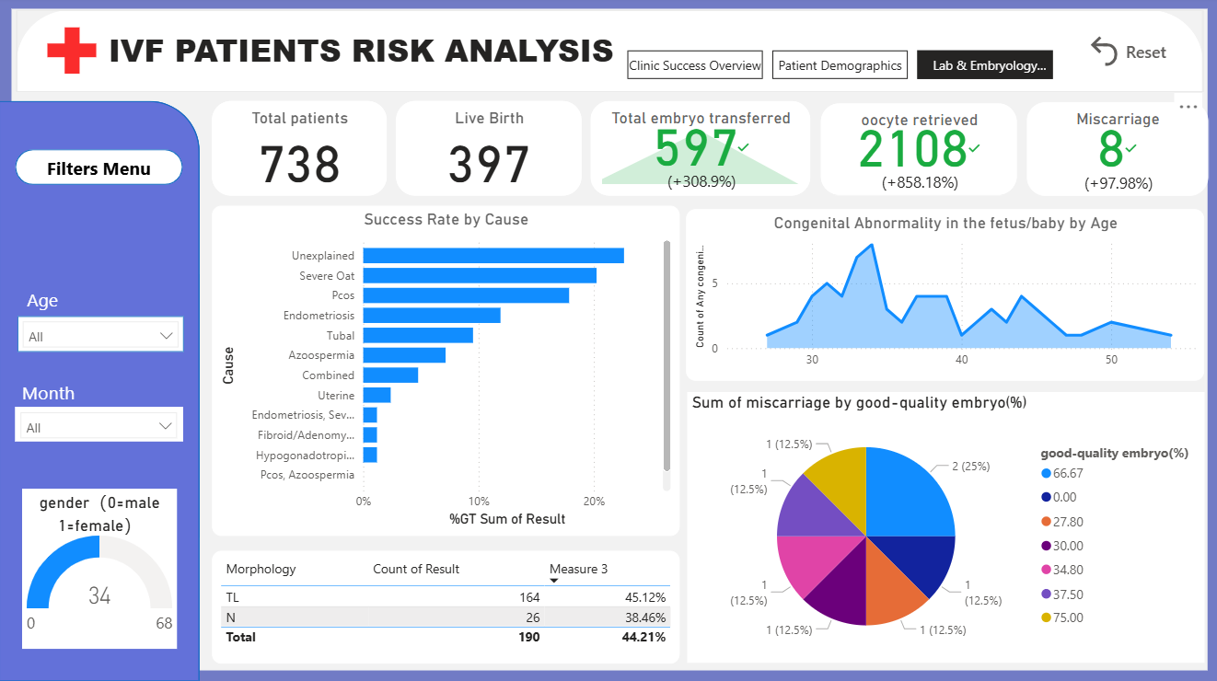
Data Visualization
Notes:
Add graphical

Slide 11


